Slide 1
Counter the Comments
Engaging with Alternate Perspectives

Slide 2

The Importance of Engaging with Alternate Views:
Your argument is more thoughtful, well-rounded, and clear.
You’re able to anticipate (not only react) to other people’s positions, ideas, and values who will undoubtedly be different from your own.
The rubric for High School Ethics Bowl rewards engaging with differing viewpoints (and conversely, your team will lose points if you forget this critical element).

Slide 3
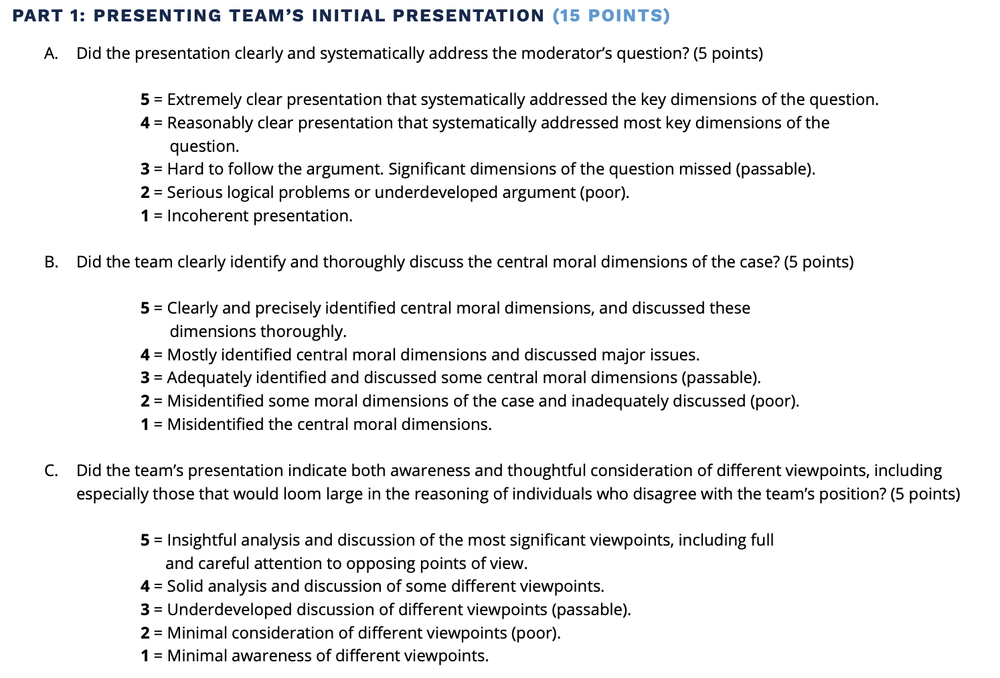
Ethics Bowl Rubric For Primary Presentations:
Any ethical dilemma or case study will have multiple moral dimensions and multiple viewpoints.
Not 1, not 2—multiple.
Identifying these dimensions and viewpoints can be the difference in an Ethics Bowl match.

Slide 4
Ethics Bowl Rubric For Primary Presentations:
Also, notice that the rubric doesn’t say you must “prove them wrong” or “disagree with all of them”.
The key words are INSIGHTFUL and THOROUGH.
Don’t reduce the other perspectives to make your side “stronger”. The goal is to engage with these perspectives in a meaningful way.

Slide 5
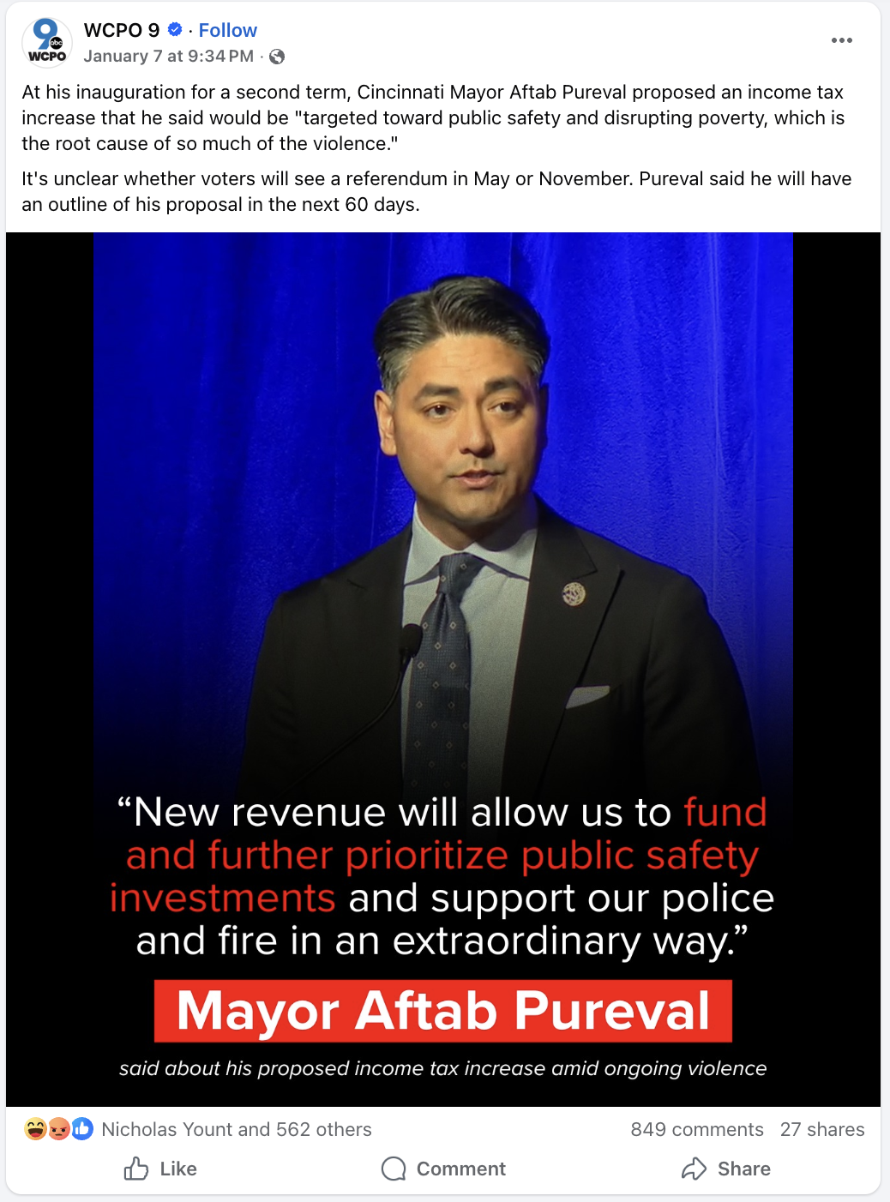
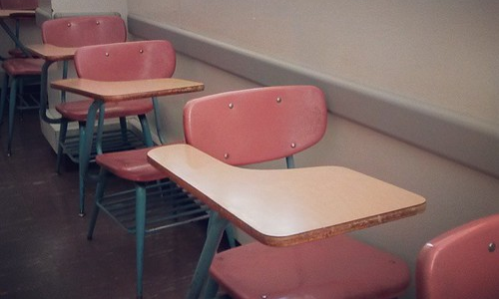
Let’s practice…
Hundreds of students at Williamsburg Central Walked out of class today for nearly 2 hours to protest. Students are calling this “a chance to speak out as citizens”. Administrators are calling it a “disruption to learning”. What do you think?
Imagine that you are scrolling through social media when you come across an article about a local high school that made the news because hundreds of students walked out of class to protest.
Let’s pretend you know very little about what sparked the protest. However, you can tell that the central moral issue at stake is whether or not students should be allowed to organize protests like this at school.
Tyler Strong..

Slide 6
Let’s look at the original post and the comments. What different perspectives do you see here? Is there anyone who seems to agree? Anyone who disagrees? Are there any “moral tensions” or “values in tension” between these different commenters?
Comments Section Tim K: No way. We need to keep students safe. How long until it turns into a mob? It only takes 1 kid… Sally R: I’m for this. I spoke with my student and it sounds like the leaders of this walk-out really care about this issue. Why can’t students show up like citizens in a democracy? It’s a fundamental right, and they feel obligated to speak out. Tom T: It’s a right for citizens. These students are minors. The law should be different when we talk about the difference between kids and adults. Sally R: What about the students who are already 18? Nia T: My daughter was there and her teacher threatened to give everyone a failing quiz grade because they missed an in class quiz. To me, that’s unfair. They should at least get a chance to make it up. Stephen P: Civil disobedience has consequences though right? Should we really pretend like it doesn’t for students? Maya L: I’ve seen a couple of parents on this post, and I agree with them. This is about what we want for our students. I think it’s fine for my students to protest, so the school needs to hear us and support our students. Ryan D: Schools have a legal obligation to protect students AND help them learn. Students missed 2 hours of class? Really? That sounds like teachers aren’t educating our students.
Hundreds of students at Williamsburg Central Walked out of class today for nearly 2 hours to protest. Students are calling this “a chance to speak out as citizens”. Administrators are calling it a “disruption to learning”. What do you think?
Tyler Strong..

Slide 7
Identifying other perspectives:
Try to identify the “moral value” or “framework” that might be motivating each commenter to feel the way they do.
For example, “Tom” seems to care about “legal rights” above all else.
Comments Section Tim K: No way. We need to keep students safe. How long until it turns into a mob? It only takes 1 kid… Sally R: I’m for this. I spoke with my student and it sounds like the leaders of this walk-out really care about this issue. Why can’t students show up like citizens in a democracy? It’s a fundamental right, and they feel obligated to speak out. Tom T: It’s a right for citizens. These students are minors. The law should be different when we talk about the difference between kids and adults. Sally R: What about the students who are already 18? Nia T: My daughter was there and her teacher threatened to give everyone a failing quiz grade because they missed an in class quiz. To me, that’s unfair. They should at least get a chance to make it up. Stephen P: civil disobedience has consequences though right? Should we really pretend like it doesn’t for students? Maya L: I’ve seen a couple parents on this post, and I agree with them. This is about what we want for our students. I think it’s fine for my students to protest, so the school needs to hear us and support our students. Ryan D: Schools have a legal obligation to protect students AND help them learn. Students missed 2 hours of class? Really? That sounds like teachers aren’t educating our students.
Legal rights

Slide 8
Engagement Methods for differing perspectives that go beyond “Counterarguments”
Engagement Method | Definition | When to use… | Example in student protest case
State clarification | Restate / summarize another perspective fairly. | When responding to specific claims When transitioning to your own claim | I noticed a lot of people already mentioned the issue of student safety. Their point is that schools have a responsibility to supervise and keep students safe. I can see that because…
Make a concession | Acknowledge a valid point from another perspective. | When accepting another person made a useful / truthful point When using a valid point to build a claim in your own argument | The administration made a valid point about the students being minors. It’s true that protesting is a civic right; however, there are a lot of differences under the law for adults and minors, so we can’t discount that fact. With that in mind, let’s consider…
Refute a claim | Explain why an opposing claim is incomplete, mistaken, or less convincing. | When illustrating a weakness in a different position When transitioning to your own claim | One teacher claimed walking out of class should be penalized in the grade book. This seems disconnected. Why give students a low grade for this behavior? Especially if it was motivated by civic duty? Instead, teachers should…

Slide 9
Engagement Method | Definition | When to use… | Example in student protest case
Qualify a claim | Put limits on a claim so it is more accurate or realistic. | When challenging the limits of someone else’s claim When defining new limits on the issue at hand | Let’s keep things in perspective. A lot of people are stating this is a “parents’ rights” issue and parents should be in control of consequences if their student attended. However, aren’t there some limits to the rights of parents in this situation? Realistically, there seems to be more evidence that…
Synthesize claims | Combine ideas from multiple perspectives into a stronger solution or claim. | When connecting multiple claims When showing relationships (cause/effect, etc) | Multiple people have brought up obligations. The students felt they had an obligation to protest, and the administration feels like they have an obligation to protect students and learning. What if these positions actually support each other? Isn’t there a way that both parties can come together and…
Identify a “Value-Motivated” Claim | Identify when another person makes a claim based on a larger value. | When digging deeper into another person’s claims When identifying values that may be connected or “in tension” | It’s clear that a lot of parents are upset about this post. One person mentioned that, “We need to keep students safe. How long until it turns into a mob?” Comments like these seem to be motivated by a deep sense of care and concern. However, in this case, “safety” has to be balanced with justice. Protests like these happen in our cities all the time. The tension between these two values can show us that…

Slide 10
Engaging With this Post
Now that you’ve identified the values / frameworks that each commenter might be using, how might you respond to them?
Focus on using 1 (or more) engagement method from your handout.
Comments Section Tim K: No way. We need to keep students safe. How long until it turns into a mob? It only takes 1 kid… Sally R: I’m for this. I spoke with my student and it sounds like the leaders of this walk-out really care about this issue. Why can’t students show up like citizens in a democracy? It’s a fundamental right, and they feel obligated to speak out. Tom T: It’s a right for citizens. These students are minors. The law should be different when we talk about the difference between kids and adults. Sally R: What about the students who are already 18? Nia T: My daughter was there and her teacher threatened to give everyone a failing quiz grade because they missed an in class quiz. To me, that’s unfair. They should at least get a chance to make it up. Stephen P: civil disobedience has consequences though right? Should we really pretend like it doesn’t for students? Maya L: I’ve seen a couple parents on this post, and I agree with them. This is about what we want for our students. I think it’s fine for my students to protest, so the school needs to hear us and support our students. Ryan D: Schools have a legal obligation to protect students AND help them learn. Students missed 2 hours of class? Really? That sounds like teachers aren’t educating our students.

Slide 11
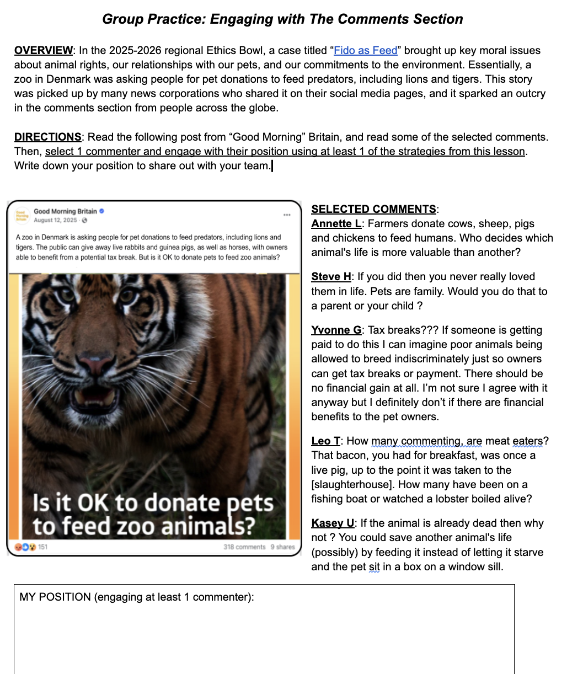
Your Turn:
Read the post and comments
With your team (or in small groups) draft your own position about this post that INCLUDES at least 1 engagement strategy from this lesson
Want more practice? Consider reading the entire “Fido as Feed” case and trying to write a primary case presentation that includes these engagement methods as well.

