Slide 1
Dissecting Questionable Reasoning in Advertisements

Slide 2
Questionable Reasoning in Advertisements
The following slides contain advertisements that you can analyze and dissect to find illogical and questionable reasoning.
While watching, consider the same questions from the print advertisements:
What is this ad “selling”?
What “reasons” does the ad use to try and convince people?
Is there anything “questionable” about the methods and reasons this advertisement uses to sell this product? What questions would a logical and reasonable person have?

Slide 3
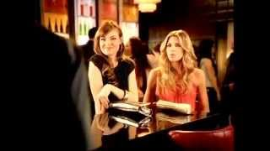

Slide 4
Taco Bell Advertisement
Where did you see “questionable” reasoning in this advertisement?
If we had to “name” this type of questionable reasoning, what could we name it?
How might someone try to use this type of questionable reasoning when discussing a moral issue?

Slide 5


Slide 6
DirecTV Advertisement
Where did you see “questionable” reasoning in this advertisement?
If we had to “name” this type of questionable reasoning, what could we name it?
How might someone try to use this type of questionable reasoning when discussing a moral issue?

Slide 7


Slide 8
Chevrolet Advertisement
Where did you see “questionable” reasoning in this advertisement?
If we had to “name” this type of questionable reasoning, what could we name it?
How might someone try to use this type of questionable reasoning when discussing a moral issue?

Slide 9
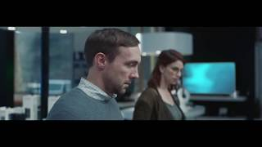

Slide 10
SimpliSafe Advertisement
Where did you see “questionable” reasoning in this advertisement?
If we had to “name” this type of questionable reasoning, what could we name it?
How might someone try to use this type of questionable reasoning when discussing a moral issue?

Slide 11


Slide 12
Ro Advertisement
Where did you see “questionable” reasoning in this advertisement?
If we had to “name” this type of questionable reasoning, what could we name it?
How might someone try to use this type of questionable reasoning when discussing a moral issue?

Slide 13
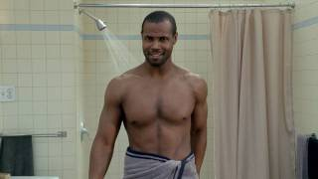

Slide 14
Old Spice Advertisement
Where did you see “questionable” reasoning in this advertisement?
If we had to “name” this type of questionable reasoning, what could we name it?
How might someone try to use this type of questionable reasoning when discussing a moral issue?

