Slide 1
Chalk Talk with
Famous Ethical Dilemmas

Slide 2
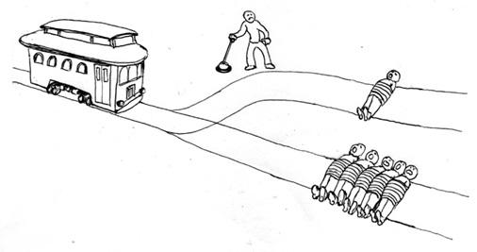
What is a “thought experiment”?
A thought experiment is an imaginary situation that is meant to test an argument, idea, or principle.
In philosophy, thought experiments are often used to test our intuitions (gut feelings) about a moral issue and to further question our principles for why we would make a certain decision.

Slide 3
Thought experiments often seem absurd or unlikely to happen. However, they often force us to make a difficult or impossible choice which can help reveal our moral principles. Take this situation, for example:
The Trolley Problem

Slide 4
The Trolley Problem
A trolley speeds down the tracks. Its brakes have failed.
Ahead, five workers stand unaware. You spot a lever — if you pull it, the trolley will switch to another track where one worker stands alone.
Do nothing, and five die. Pull the lever, and one dies because of your choice.
Your hand hovers over the lever as the trolley rushes closer. What do you do?

Slide 5
Let’s Discuss… With a Chalk Talk:
“Doing Nothing” seems wrong… I think you should at least try to yell at them or something.
I would pull the lever. That’s what a good samaritan would do.
A trolley speeds down the tracks. Its brakes have failed.
Ahead, five workers stand unaware. You spot a lever — if you pull it, the trolley will switch to another track where one worker stands alone.
Do nothing, and five die. Pull the lever, and one dies because of your choice.
Your hand hovers over the lever as the trolley rushes closer. What do you do?
True. I wonder if there’s another option. Like yelling at them or throwing something in front of the train?
But how can you judge the quality of their lives? What if that one person is a nobel peace prize winner?
Yeah, but why waste time and risk it? Just pull the level. It’s not great, but it has to be done.
Good point. How do we judge the value of 1 life versus 5?

Slide 6

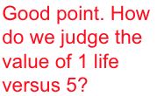
Chalk Talk with 6 Famous Thought Experiments
You’ll have 4-5 minutes to read and annotate each “Thought Experiment”.
Make sure to write comments, connections, and questions with arrows (Look at the model).
After the timer stops, switch papers! Respond to the new thought experiment and the comments of the previous readers.
“Doing Nothing” seems wrong… I think you should at least try to yell at them or something.
MODEL
A trolley speeds down the tracks. Its brakes have failed.
Ahead, five workers stand unaware. You spot a lever — if you pull it, the trolley will switch to another track where one worker stands alone.
Do nothing, and five die. Pull the lever, and one dies because of your choice.
Your hand hovers over the lever as the trolley rushes closer. what do you do?
I would pull the lever. That’s what a good samaritan would do.
True. I wonder if there’s another option. Like yelling at them or throwing something in front of the train?
But how can you judge the quality of their lives? What if that one person is a nobel peace prize winner?
Yeah, but why waste time and risk it? Just pull the level. It’s not great, but it has to be done.
Good point. How do we judge the value 1 life versus 5?

Slide 7
Reflection Questions for Consideration:
What principles or values guided your reasoning during these experiments?
Where do our notes show examples, evidence, and connections that connect with the central moral dilemma of the case?
Where do our notes show signs of agreements / disagreements? Claims / counterclaims?
How might the 6 Moral Frameworks connect with these experiments? (See next slide for frameworks)

Slide 8
Name of Framework | Definition / Use cases | Questions worth asking with this framework
Consequences | This framework for analyzing ethical dilemmas focuses on the outcomes of actions. It often focuses on the total amount of “harm” or “good” that might come from an action. | Who will be affected by this action? How much “harm/good” will come from this action? What is the best action/outcome for the majority of people affected by this?
Inner Thoughts | This framework for analyzing ethical dilemmas focuses on people’s “motive” or “intention” for specific actions. | What is the motivation behind an action? What was the original intention of the action? Does that matter? Did someone have (or lack) knowledge when the action was done? How do a person’s “inner thoughts” affect the rightness or wrongness of an action?
Foundational Ideals | This framework for analyzing ethical dilemmas focuses on “rights” or “ideals” (values) that connect to a specific action. | What rights or ideals connect to this specific action? How do these rights / ideals connect with a specific action?
Care & Relationships | This framework for analyzing ethical dilemmas focuses on a person’s “needs” or “relationships” that might matter in the context of a specific action. | What relationships are at stake? Is there anything special / important about the nature of the relationship? Is there a priority or obligation to care for someone’s needs?
Social Agreements | This framework for analyzing ethical dilemmas focuses on “agreements” (both spoken and unspoken) and contacts (both written or implied) that people may have with each other. | Are there any unspoken/implicit agreements that someone might think is in play in this situation? Are there any explicit “contracts” or binding agreements that might come into play?
Virtues | This framework for analyzing ethical dilemmas focuses on values, character traits, and virtues that a person might have. | Does this decision/action go against any core virtues that someone might value? Does this decision/action lead to the “decline” or “growth” of a specific virtue or character trait within a specific person or our society?

