Slide 1
4-Corner Debate:
The 10 “Commandments” of Philosophy
Inspired by Bertrand Russell

Slide 2

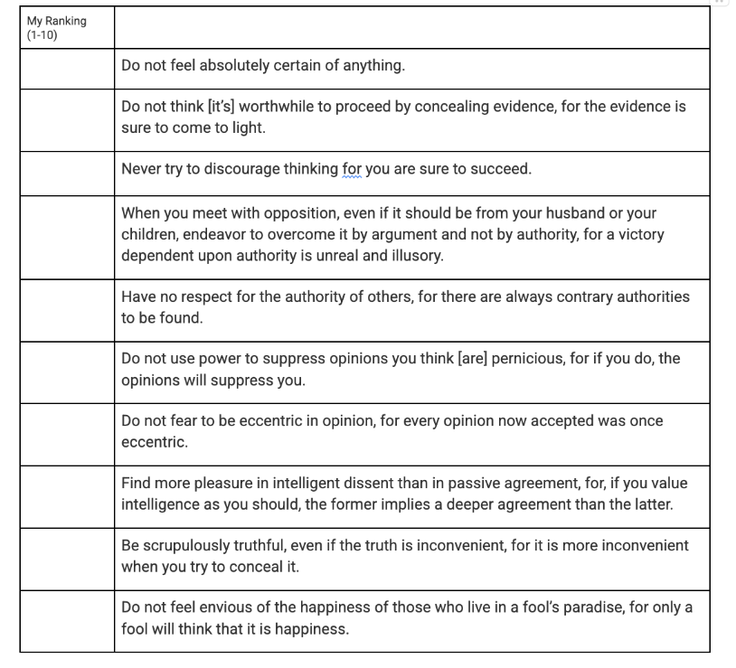
Bertrand Russell’s “10 Commandments”...
In 1951, Bertrand Russell—a well known philosopher, writer, and teacher—wrote an article in the New York Magazine titled, “The Best Answer to Fanaticism–Liberalism”. This article lays out his beliefs about how citizens should think in a democracy.
Near the end of the article, Russell decides to come up with his own “10 Commandments” for his students and all philosophers. Despite the name, these are not religious rules to be followed. Rather, he came up with 10 rules that he believes all philosophers—like you—should consider when thinking about complex problems such as morality and ethics.
DIRECTIONS: Read the “commandments” on the page in front of you. Rank them in order based on their “usefulness” in Ethics Bowl! Be ready to explain your reasoning.

Slide 3
Four Corner Debate!
Strongly Agree
Agree
Move to the corner of the room that represents your opinion about the following statements. After, we will discuss why we moved to each corner.
Disagree
Strongly Disagree

Slide 4
Strongly Agree
Agree
Some opinions are too dangerous to be heard.
Disagree
Strongly Disagree

Slide 5
Strongly Agree
Agree
It’s okay to bend the truth if it helps your cause.
Disagree
Strongly Disagree

Slide 6
Strongly Agree
Agree
There are some things that are always impermissible
—No matter what.
Disagree
Strongly Disagree

Slide 7
Strongly Agree
Agree
Challenging authority usually does more harm than good.
Disagree
Strongly Disagree

Slide 8
Strongly Agree
Agree
People should be punished for having harmful ideas.
Disagree
Strongly Disagree

Slide 9
Strongly Agree
Agree
It’s dangerous to question widely accepted ideas.
Disagree
Strongly Disagree

Slide 10
Strongly Agree
Agree
It’s better to win an argument than to understand the other side.
Disagree
Strongly Disagree

Slide 11

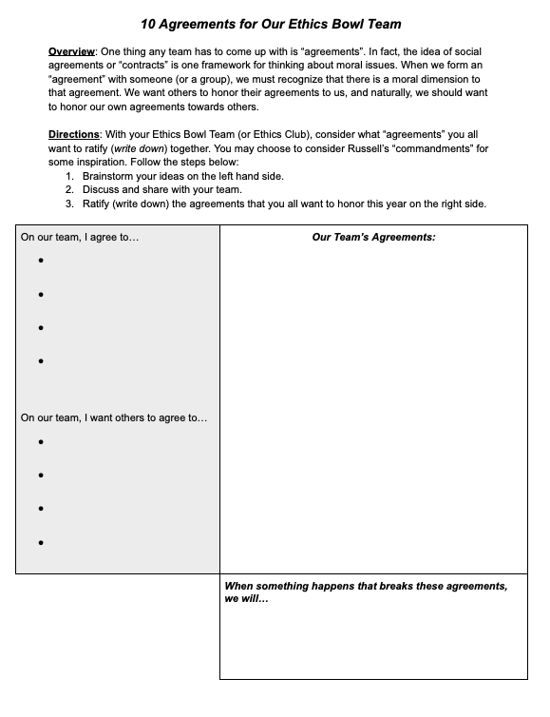
Let’s Create some “Agreements” for our team!
Turn over your handout and read the overview and directions to create your own agreements!
Brainstorm your own ideas (3 minutes)
Discuss and share as a team (5 minutes)
Ratify (write down) your team’s shared agreements (10 minutes)

