Slide 1
Breaking The Code:
Professional Ethics

Slide 2
Professional Ethics
Professional Ethics are the moral principles and values that guide professionals in in the work that they do. Often, each profession will have a formalized “Code of Ethics” which will highlight key values and principles that every member of that profession should practice.
What principles and values do you think the following professionals should follow?
Doctors
Nurses
Lawyers
Teachers
Journalists
Business professionals
Engineers
Psychologists

Slide 3
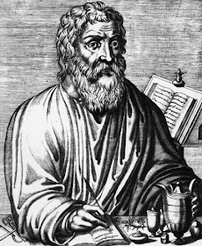
Consider Doctors…
Doctor’s all pledge to follow the Hippocratic Oath, which covers some of the following values and principles:
Beneficence – Act in the best interest of the patient; promote health and well-being.
Nonmaleficence – “Do no harm.” Avoid causing unnecessary pain, injury, or risk.
Autonomy – Respect the patient’s right to make informed decisions about their own care.
Confidentiality – Protect patients’ private medical information unless disclosure is ethically or legally required.
Justice – Treat patients fairly, without discrimination; ensure equitable access to medical care.

Slide 4

Let’s Look at Someone Breaking the Code…
How might these business professionals be violating the “Business Code of Ethics”?
Excerpted from the NBC Series The Good Place

Slide 5
Another Example of Business Ethics:
Recently, Tye started working at Nex-Gen: A company who claims to be committed to clean energy. Tye joined Nex-Gen as a sales representative. He was excited to sell their solar panels to eager home owners who wanted to save money while supporting a clean environment. Unfortunately, last week, one of the engineers mentioned that the lifespan of the solar panels is less than 10 years—apparently they’re made cheaply with materials that aren’t built to last. He even overheard them talking about faulty wires leading to fires. What should he do?

Slide 6

Breaking The Code
1. With a group, pick a profession from the list below:
Doctors
Nurses
Lawyers
Teachers
Journalists
Business professionals
Engineers
Psychologists
2. Then, with your group members, read over the general Code of Ethics handout for your profession.
3. After reading, create a fake scenario that would require someone in that profession to make a tough, moral decision.
When we are done, we will share out our scenarios and test these ethical codes.

Slide 7
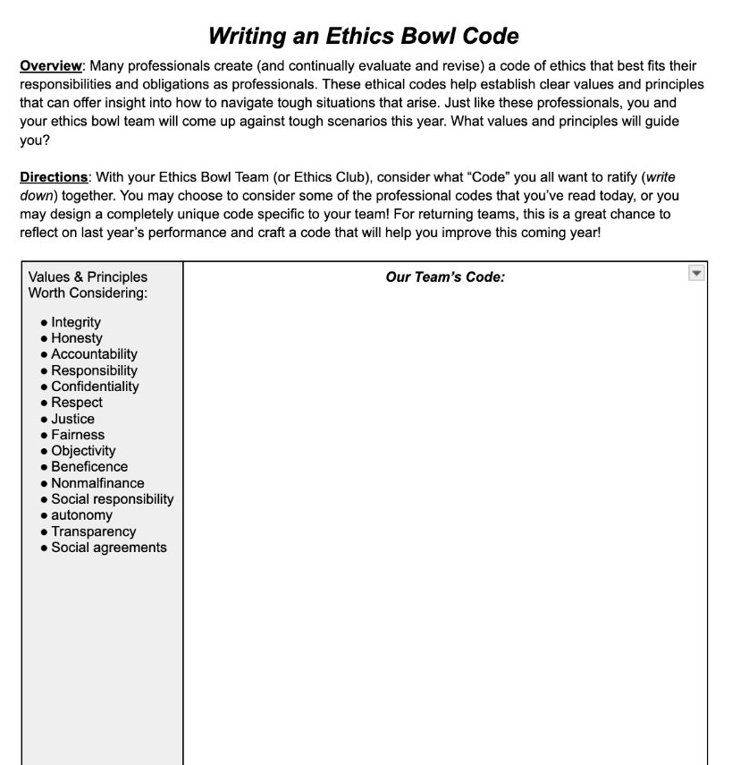
Create Your Own Ethics Bowl Code
As a team, work together to create your own “code” that will help you as you prepare for future Ethics Bowl matches! This is a great chance to build a code that helps your team set norms, expectations, and highlight important values that will come up during your conversations.

