Slide 1
The 10 “Agreements”
of Ethics Bowlers
Inspired by Bertrand Russell

Slide 2
You’re hired!
Your Ethics Bowl team had been hired by a new tech start-up, Mandatum, to consult about an ethical dilemma they are having. They are getting ready to release a fully functioning “Robot Maid”, which they predict will be desired in every home to help do chores like the dishes, laundry, and tidying up. However, they also know the robot will need to interact with humans and make important decisions. For example, how will they interact with the adults in the household? How will they act with children? Essentially, Mandatum believes that this robot will need “Moral Commandments” to follow so it knows what is “right” or “wrong”. They want to make a good robot—one that people will trust. The company has hired you to come up with these “commandments”. What do you believe they should be?

Slide 3

Your Ethics Bowl team had been hired by a new tech start-up, Mandatum, to consult about an ethical dilemma they are having. They are getting ready to release a fully functioning “Robot Maid”, which they predict will be desired in every home to help do chores like the dishes, laundry, and tidying up. However, they also know the robot will need to interact with humans and make important decisions. For example, how will they interact with the adults in the household? How will they act with children? Essentially, Mandatum believes that this robot will need “Moral Commandments” to follow so it knows what is “right” or “wrong”. They want to make a good robot—one that people will trust. The company has hired you to come up with these “commandments”. What do you believe they should be?
Commandments for Robots…

Slide 4

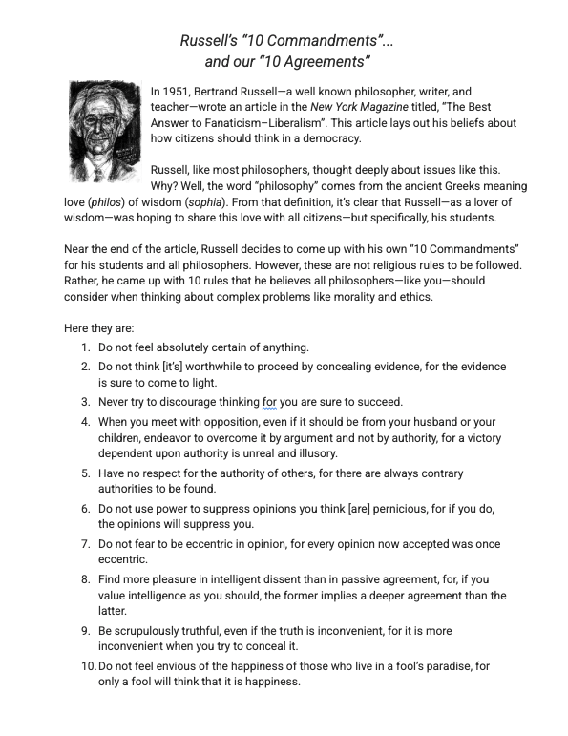
Let’s consider Bertrand Russell’s Commandments
Read the handout about Bertrand Russell’s “10 Commandments” for philosophers.
As you go, annotate for the following:
  Circle any words you don’t know
  UNDERLINE any main ideas or important details
  ✅ Put a checkmark by anything you agree with
  ❌ Put an X by anything you disagree with

Slide 5
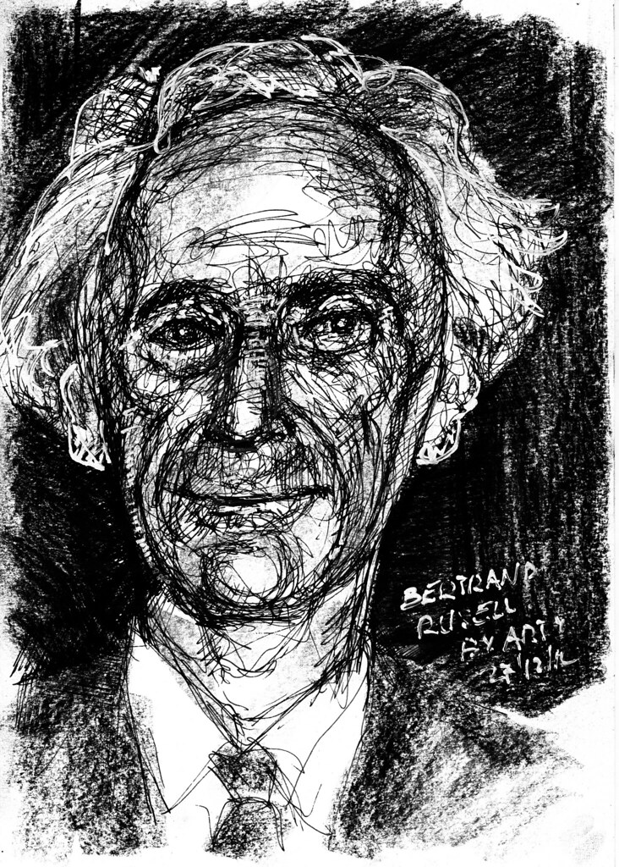
Bertrand Russell’s “10 Commandments”...
Do not feel absolutely certain of anything.
Do not think [it’s] worthwhile to proceed by concealing evidence, for the evidence is sure to come to light.
Never try to discourage thinking for you are sure to succeed.
When you meet with opposition, even if it should be from your husband or your children, endeavor to overcome it by argument and not by authority, for a victory dependent upon authority is unreal and illusory.
Have no respect for the authority of others, for there are always contrary authorities to be found.

Slide 6
Bertrand Russell’s “10 Commandments”...
Do not use power to suppress opinions you think [are] pernicious, for if you do, the opinions will suppress you.
Do not fear to be eccentric in opinion, for every opinion now accepted was once eccentric.
Find more pleasure in intelligent dissent than in passive agreement, for, if you value intelligence as you should, the former implies a deeper agreement than the latter.
Be scrupulously truthful, even if the truth is inconvenient, for it is more inconvenient when you try to conceal it.
Do not feel envious of the happiness of those who live in a fool’s paradise, for only a fool will think that it is happiness.

Slide 7
The Difference Between “Commandments” and “Agreements”
Commandments
Agreements

Slide 8
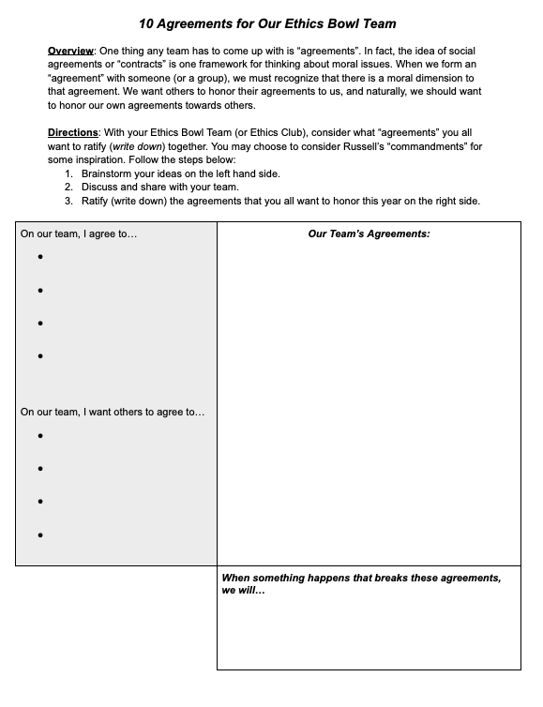
Let’s Create some “Agreements” for our team!
Read the handout about Bertrand Russell’s “10 Agreements for Our Ethics Bowl Team”
Brainstorm your own ideas (3 minutes)
Discuss and share as a team (5 minutes)
Ratify (write down) your team’s shared agreements (10 minutes)

Slide 9
Slides after this are “Drafts” or may not fit right now.

Slide 10
Consider this…
Jay signed up to volunteer with his cousin, Will, at a nearby park. They haven’t been close in a long time, but Jay thinks volunteering together might help them bond. The park has been filled with litter for months. It used to be a crowded and clean, but now it’s filled with weeds and trash—barely any families bring their children. The day before the volunteer clean up, Jay gets a text from his best friend, Joe. Joe has an extra (free) concert ticket to see their favorite musician. Jay has been wanting to see them perform for years.
While part of Jay wants to go to the concert, there is another part of him that is worried about breaking the agreement he made with his cousin.

